Slide 1
Registering yourself as OB10 supplier
Please wait for the email from e-invoicing@kaust.edu.sa with the link and registration key
For the first time, only use OB10 link provided in the email. After creating OB10 account, you can access directly by using URL: www.ob10.com
Password and secret question is compulsory and can be anything you like.
Please use your KAUST email and not your personal email
No need to give bank information, Vendor code, GL or cost center
When you create your OB10 account please provide only the requested information, which we have highlighted in this document (highlighted in red boxes), the other information is not needed

Slide 2
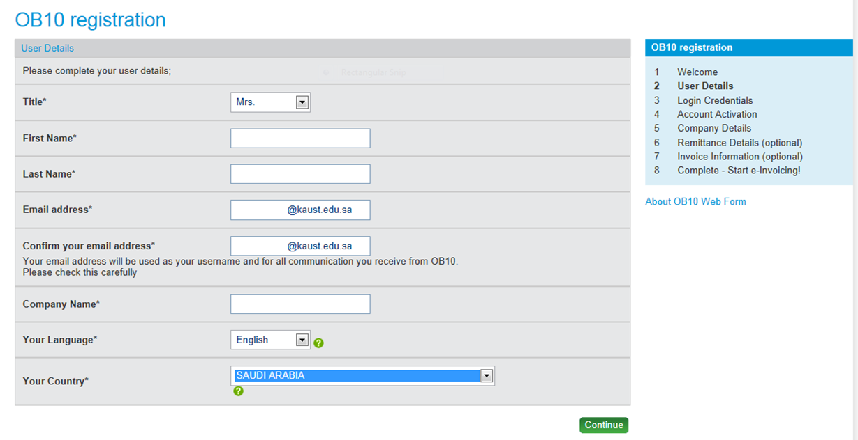
Your First Name Here
Your last name here
Your Kaust Email address
Your Kaust Email address again
Your complete name

Slide 3
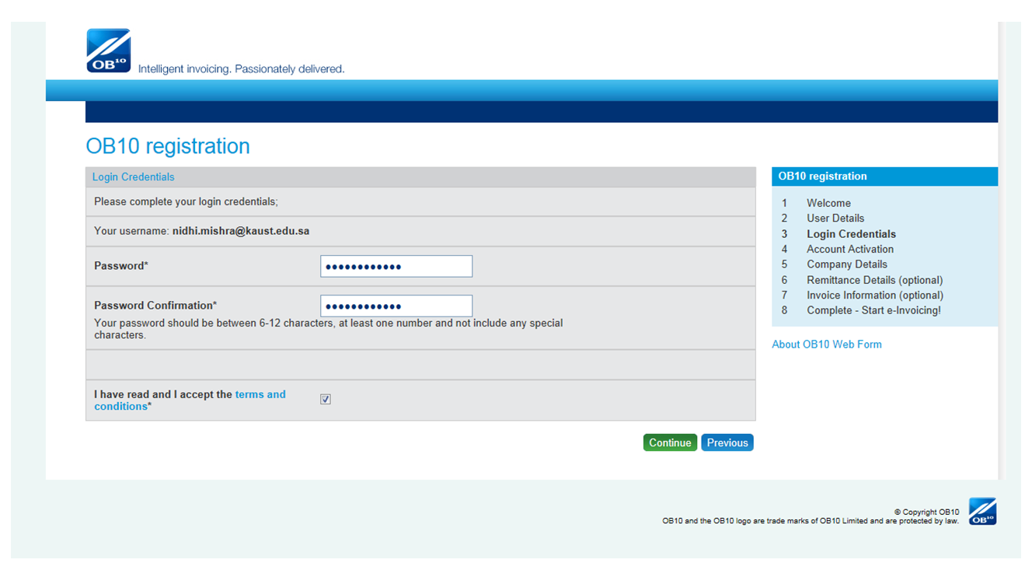

Slide 4
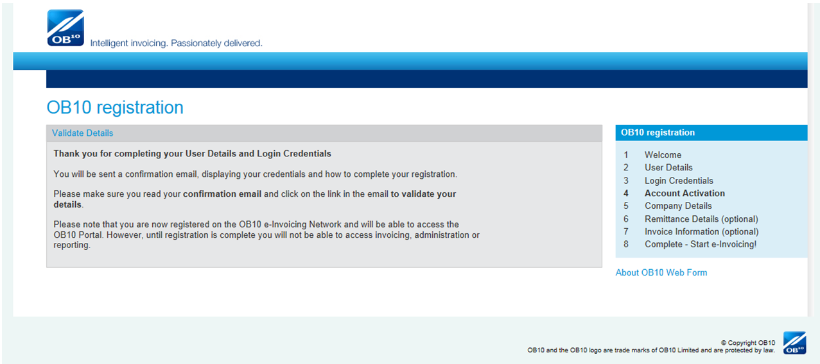

Slide 5
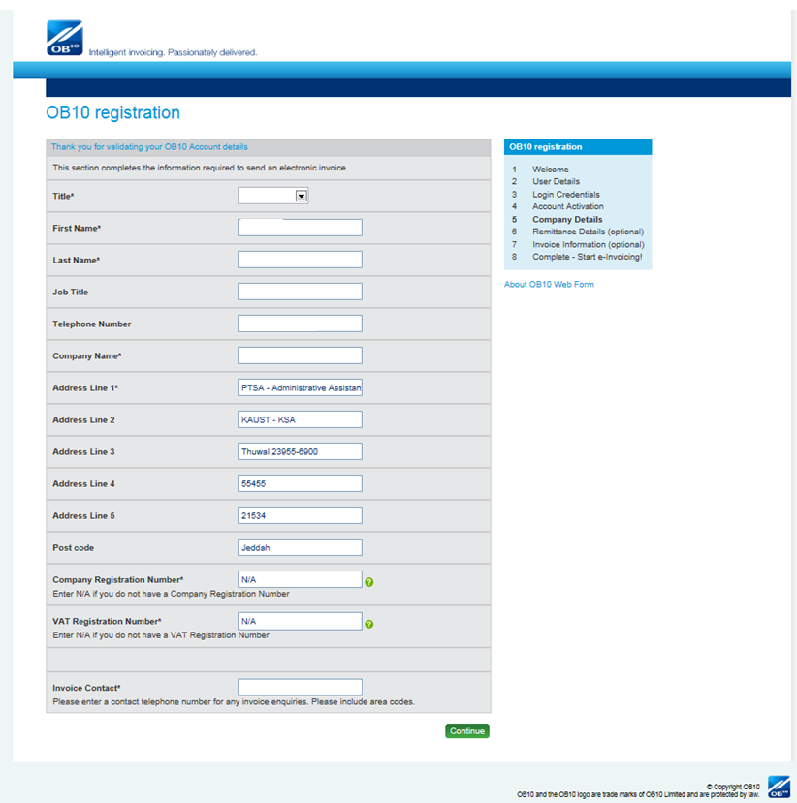
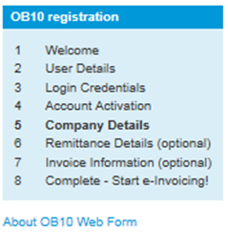
Your First Name Here
Your Last Name Here
Your Complete name here
Just write “KAUST”
“N/A”
“N/A”
KAUST phone 012-808-XXXX

Slide 6
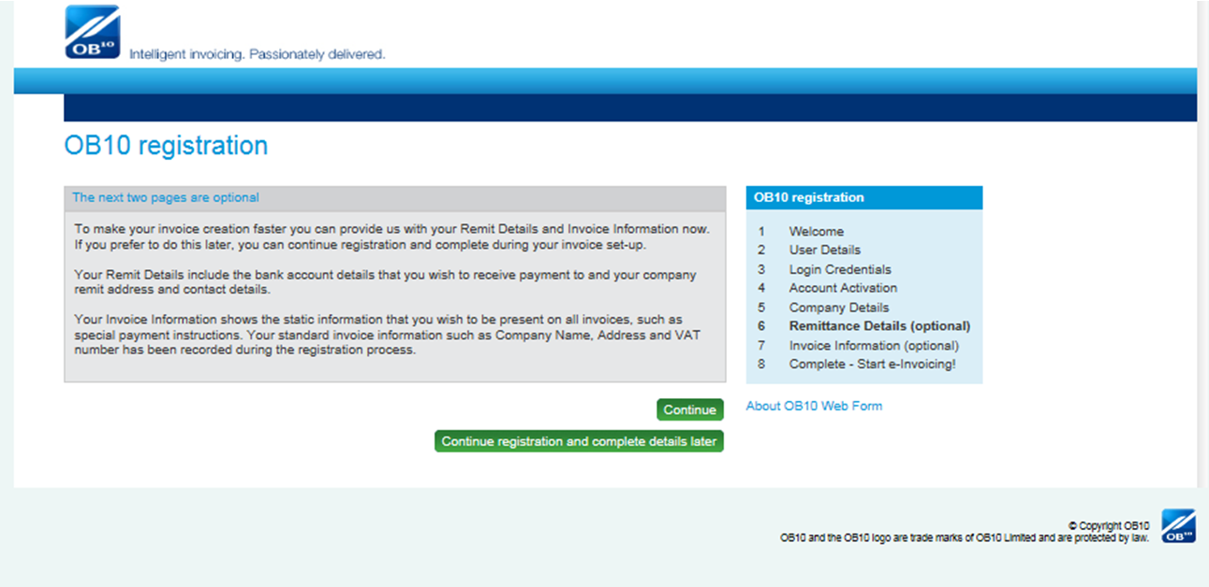
If you click this, you will be taken to last screen automatically skipping 6 & 7
- Recommended

Slide 7
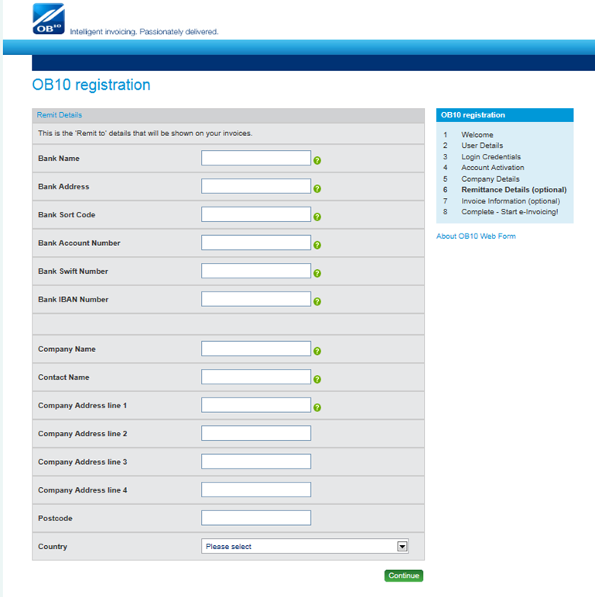
Leave the whole screen blank

Slide 8
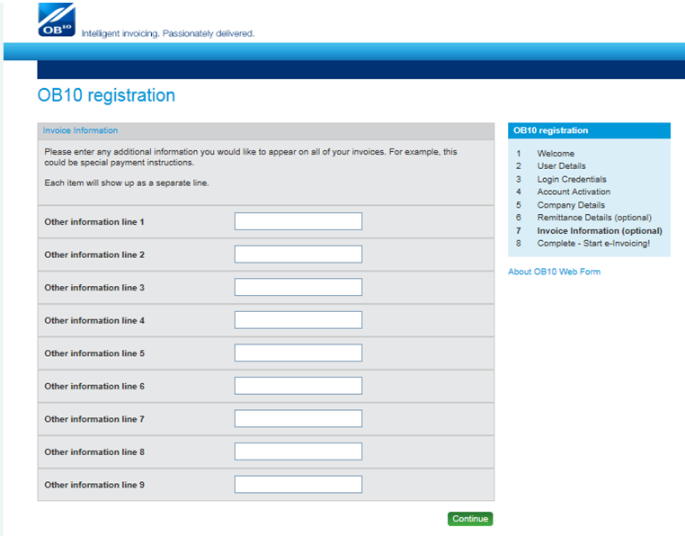
Leave the whole screen blank

Slide 9
